Slide 1
HELP from ABOVE
Supporting your CPAs
Nicholas Rogers,
NREd Consulting, LLC

Slide 2
What does it all mean?
CTE
Career Pathway
Career Academy
CPA
Vocational Education
ROP course
CTE course
Notes:
Create / Share common language

Slide 3
CAREER TECHNICAL EDUCATION is a program of study that involves a multi-year sequence of courses that integrate core academic knowledge with technical and occupational knowledge to provide students with pathways to post-secondary education and careers.

Slide 4
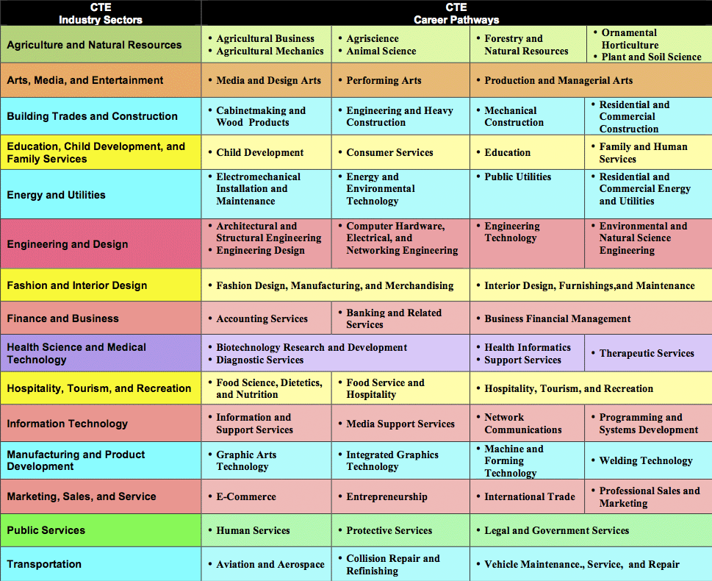
Industry Sectors & Pathways
Notes:
Career Pathways Handout for activity
What are they
Show sectors

Slide 5
Career pathway
Specific Career
of Interest
Introductory
Course
Concentrator
Course
Completer
Course

Slide 6
CTE #2 CAREER ACADEMY MODEL
CTE Pathway
Career Academy
College & Career Ready
Rigorous
Academics
A-G
INTEGRATED INSTRUCTION
COMPLEMENTARY INITIATIVES

Slide 7
Career academy
Voluntary: Teams of both students and teachers who share an interest in the career focus of the academy and work together for an extended period of time.

Slide 8
Career academy
Career focus: The career technical focus of an academy is determined by an analysis of the local labor market, particularly fields that are growing and healthy, offer opportunities with career mobility, and feature companies willing to support the program. CTE is kept broad, focusing on industries rather than specific jobs. Students should be introduced to all aspects of the focus industry as they investigate career possibilities of personal interest. This RFA is focused on careers in clean technology and renewable energy.

Slide 9
Career academy
Curriculum: The curriculum is focused on a career field and coordinated with related academic and career technical classes. The CTE curriculum should include a logical sequence of courses that address the career theme of the academy and prepare students for postsecondary education and beginning level employment in clean technology and renewable energy careers. The integration of an academic and career technical curriculum, aligned with the academic and CTE standards, is a key ingredient.
.

Slide 10
Career academy
Staffing: Teachers ask to participate in the program usually because of an interest in the career theme of the academy and/or an interest in working with a team of teachers in a collegial atmosphere. Teachers are required to have a common planning period to meet regularly to: (a) plan the program activities and curriculum; (b) coordinate with business representatives; (c) meet with parents; and (d) assess student and program progress.

Slide 11
Career academy
Student selection: Students voluntarily apply, are interviewed, and are selected on the basis of need and interest. About 60 to 80 students are typically selected for entry each year, enough to makeup two sections of a sophomore class. At least 50 percent of students selected for entry must meet criteria for “at-risk” students as described in this RFA.

Slide 12
Career academy
Business involvement: Each academy has a partnership with employers who will: (a) serve on an academy steering committee; (b) help to develop the career technical curriculum; (c) provide speakers for academy classes; (d) host field trips to give students a perspective of the workplace; (e) provide mentors who serve as career related role models and personal points of contact; and (f) provide job shadowing, internship, and other work experience opportunities.

Slide 13
Career academy
Partnership: The business community, community college(s), other postsecondary education and community organizations, and the school district form a partnership to: (a) provide students with opportunities for mentorships, internships, articulated career paths and other means of enhancing an understanding of the world of work and continuing education; and (b) assist teachers in developing curricula that mirrors modern careers.

Slide 14
Career academy
Motivational activities: Motivational activities with private sector involvement encourage students’ active involvement in their education to enhance both academic growth and career preparation.
Mentorship: In the eleventh grade, academy students are matched with mentors. A mentor is usually an employee of a participating business or organization who volunteers to be a career related role model, a friend in the industry, and a caring adult in the student’s life.

Slide 15
Career academy
Internships: After their junior year, students are placed in internships. These internships typically take place either during the summer after the junior year or during senior school year. Scheduling challenges, transportation, and workplace opportunities should be considered when arranging internships. Students apply for these positions as they would in the open market. For example, they prepare résumés, complete job applications, and have interviews. An internship is focused on advancing a student’s knowledge and understanding of the career field and the diverse aspects of an industry.

Slide 16
Career academy
Postsecondary alignment: Academy programs must develop curricular paths, including sequenced CTE courses that go beyond high school graduation and lead to a variety of degree and certificate programs. Alignment with postsecondary programs in the academy’s career focus is critical and required.
Assessment: CPAs are required to submit an annual report in October of each year, providing detailed student and program data. This report determines amount of funding earned for the previous school year.

Slide 17
Career academy
Professional Development: Attendance at the annual conference is required. It is required that at least three members of the academy team attend annually; however, we recommend that the entire academy team, and the school administrators responsible for the academy, attend this year.

Slide 18
Issues….
We all got ‘em.

Slide 19
Your priorities
Student welfare and achievement
College, college, college
A-G
Closing the achievement gap
Small Learning Communities/Small Schools
CAHSEE
Dropout prevention
College and Career Readiness
Facilities maintenance, improvement, construction, ADA compliance
Keeping all constituents happy

Slide 20
issues
Scheduling
Staffing – assigning and changing
Charges of elitism
Too many mandates
Purity of classes
A-G
Resistance in school to change

Slide 21
Where do I start?

Slide 22
Make the case educate

Slide 23
Teachers
Board
Advisors
&
Counselors
Career
Academy
Stakeholders
Administration
Parents/
Community
Employer Partners
Business Partners

Slide 24
Making the case
Our kids must have access to rigorous academics that will prepare them for the future.
CPAs are all about contextualizing academic instruction.
Notes:
Fun facts

Slide 25
Making the case
We’ve got to focus on standards, CAHSEE and A-G.
CPAs are the best way to cover it all.
CTE standards have academic rigor aligned with common core
When curriculum designed collaboratively, best chance for academic rigor and A-G approval
Notes:
Fun facts

Slide 26
Making the case
Don’t track my kid!
Students shouldn’t have to decide on a career so early.
Notes:
Fun facts

Slide 27
Making the case
Confidence and connections.
Teaching transferrable skills (SCANS)
Average six careers
(20% not yet invented).
Notes:
Fun facts

Slide 28
Making the case
Career academies are elitist.
Mandatory recruitment of at-risk youth
Notes:
Fun facts

Slide 29
Be prepared. Arm yourself
Academy components
Sample standards and lessons
Data (on achievement, attendance, dropout rate, internships/jobs, business connections, post-secondary success)
News stories
Anecdotal evidence
Labor Market – high-growth, high-wage
Notes:
Fun facts

Slide 30
integrate

Slide 31
Career Academy
Requirement
JOBS &
INTERNSHIPS
CAN CROSS PROGRAMS
Perkins Requirements
CTE Pathways Requirements
Work Experience Education

Slide 32
Support sustainability
Common-planning time
Add/Modify data-fields
Collaborate fully with business partners
Support legislation
Don’t keep changing CPA staff

Slide 33
Support buy-in
PROFESSIONAL DEVELOPMENT
Teachers for buy-in
Counselors are key
Other administrators
Board of Education
Business Services/Fiscal staff
Facilities

Slide 34
Support Throughout School
Encourage events that show off work-based learning projects
Make business partner(s) welcome
Invite Board and community members, including politicians
Have CPA build coalition with other staff
Business cards
Culinary project
Video someone’s class or event
Notes:
Marketing

Slide 35
Support Outside of School
Visit a model program and include administrator(s), business partner(s) and Board member(s)
Assist with and/or sit on business advisory
Encourage partners and higher-ups to go to conferences with you.
Try to get partners to sponsor trips
Notes:
Marketing

Slide 36
And…
…seek opportunities to…

Slide 37
LEVERAGE

Slide 38
CPAs create
Opportunities for funding
New construction and renovation
QZAB
Prop 1D
Business donations
Business match

Slide 39
NREd Consulting, LLC
Website:
www.nredco.com
Email:
nr@nredco.com
Telephone number:
760 321-9096

